Slide 1
Lösung des n-Damenproblems auf einem adiabatischen Quantencomputer

Slide 2
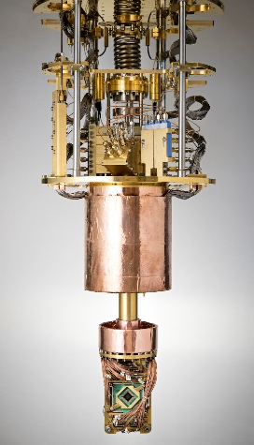
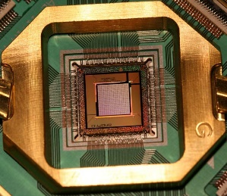
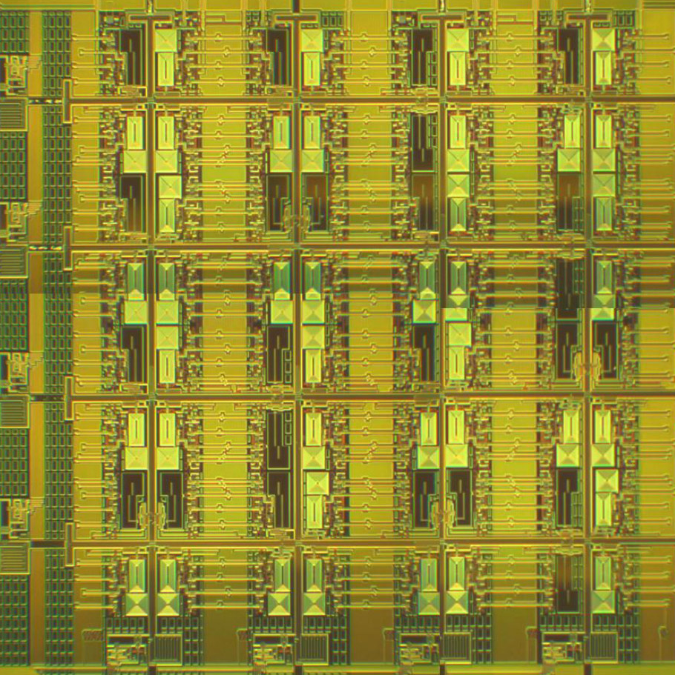
Funktionsweise eines adiabatischen Quantencomputers
Die QPU („Quantum Processing Unit“) ist der Prozessor, das „Herz“ des Quantencomputers. Sie ist mit einem Kühlungssystem umgeben, das sie auf 15mK (ca. -237,2°C) kühlt.
Die QPU besteht aus „Qubits“. Diese Qubits haben entweder die Werte 0 oder 1 oder befinden sich in der Überlagerung beider Zustände, der Superposition. Sobald man den Wert misst „entscheidet“ sich das Qubit für einen der Werte.
0
1
0
0
1
0
1
1
Außerdem lassen sich die Qubits mit den sog. Gleichheits- oder Ungleichheits-kopplern verschalten, sodass sie entweder immer den gleichen, oder immer den entgegengesetzten Wert haben.
Gleichheit
Messung
1
1
0
0

Slide 3
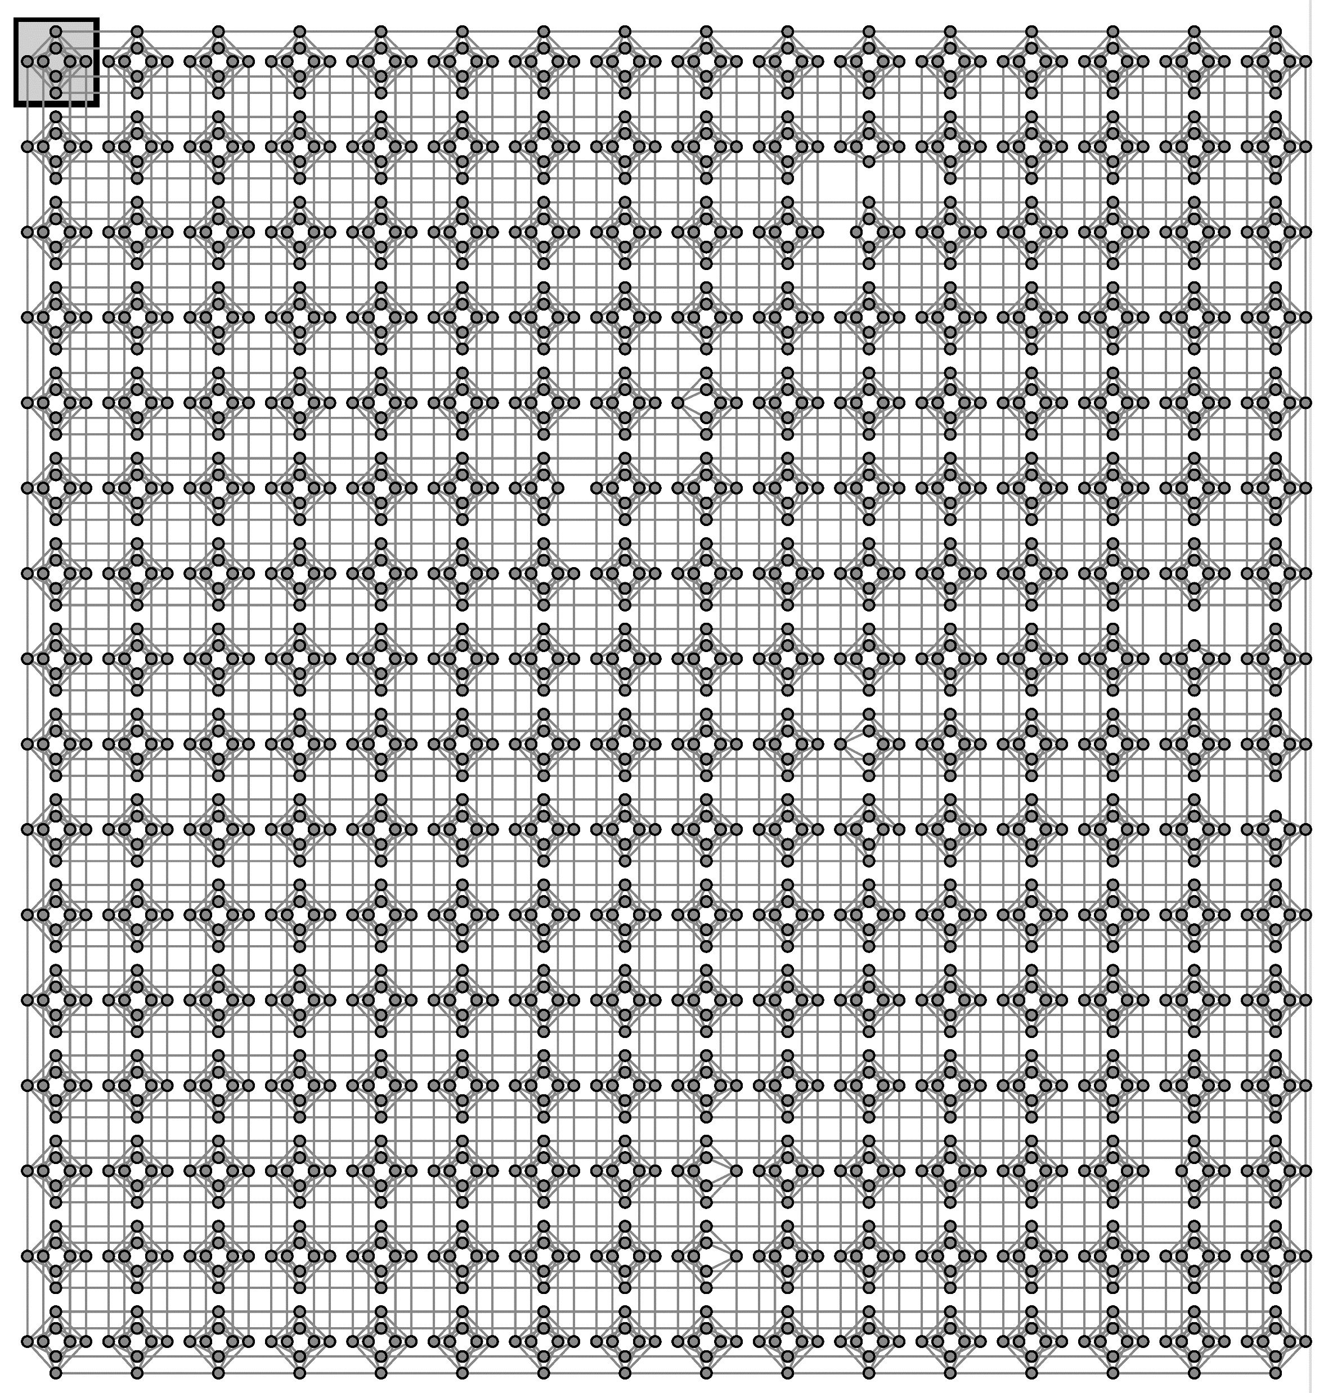
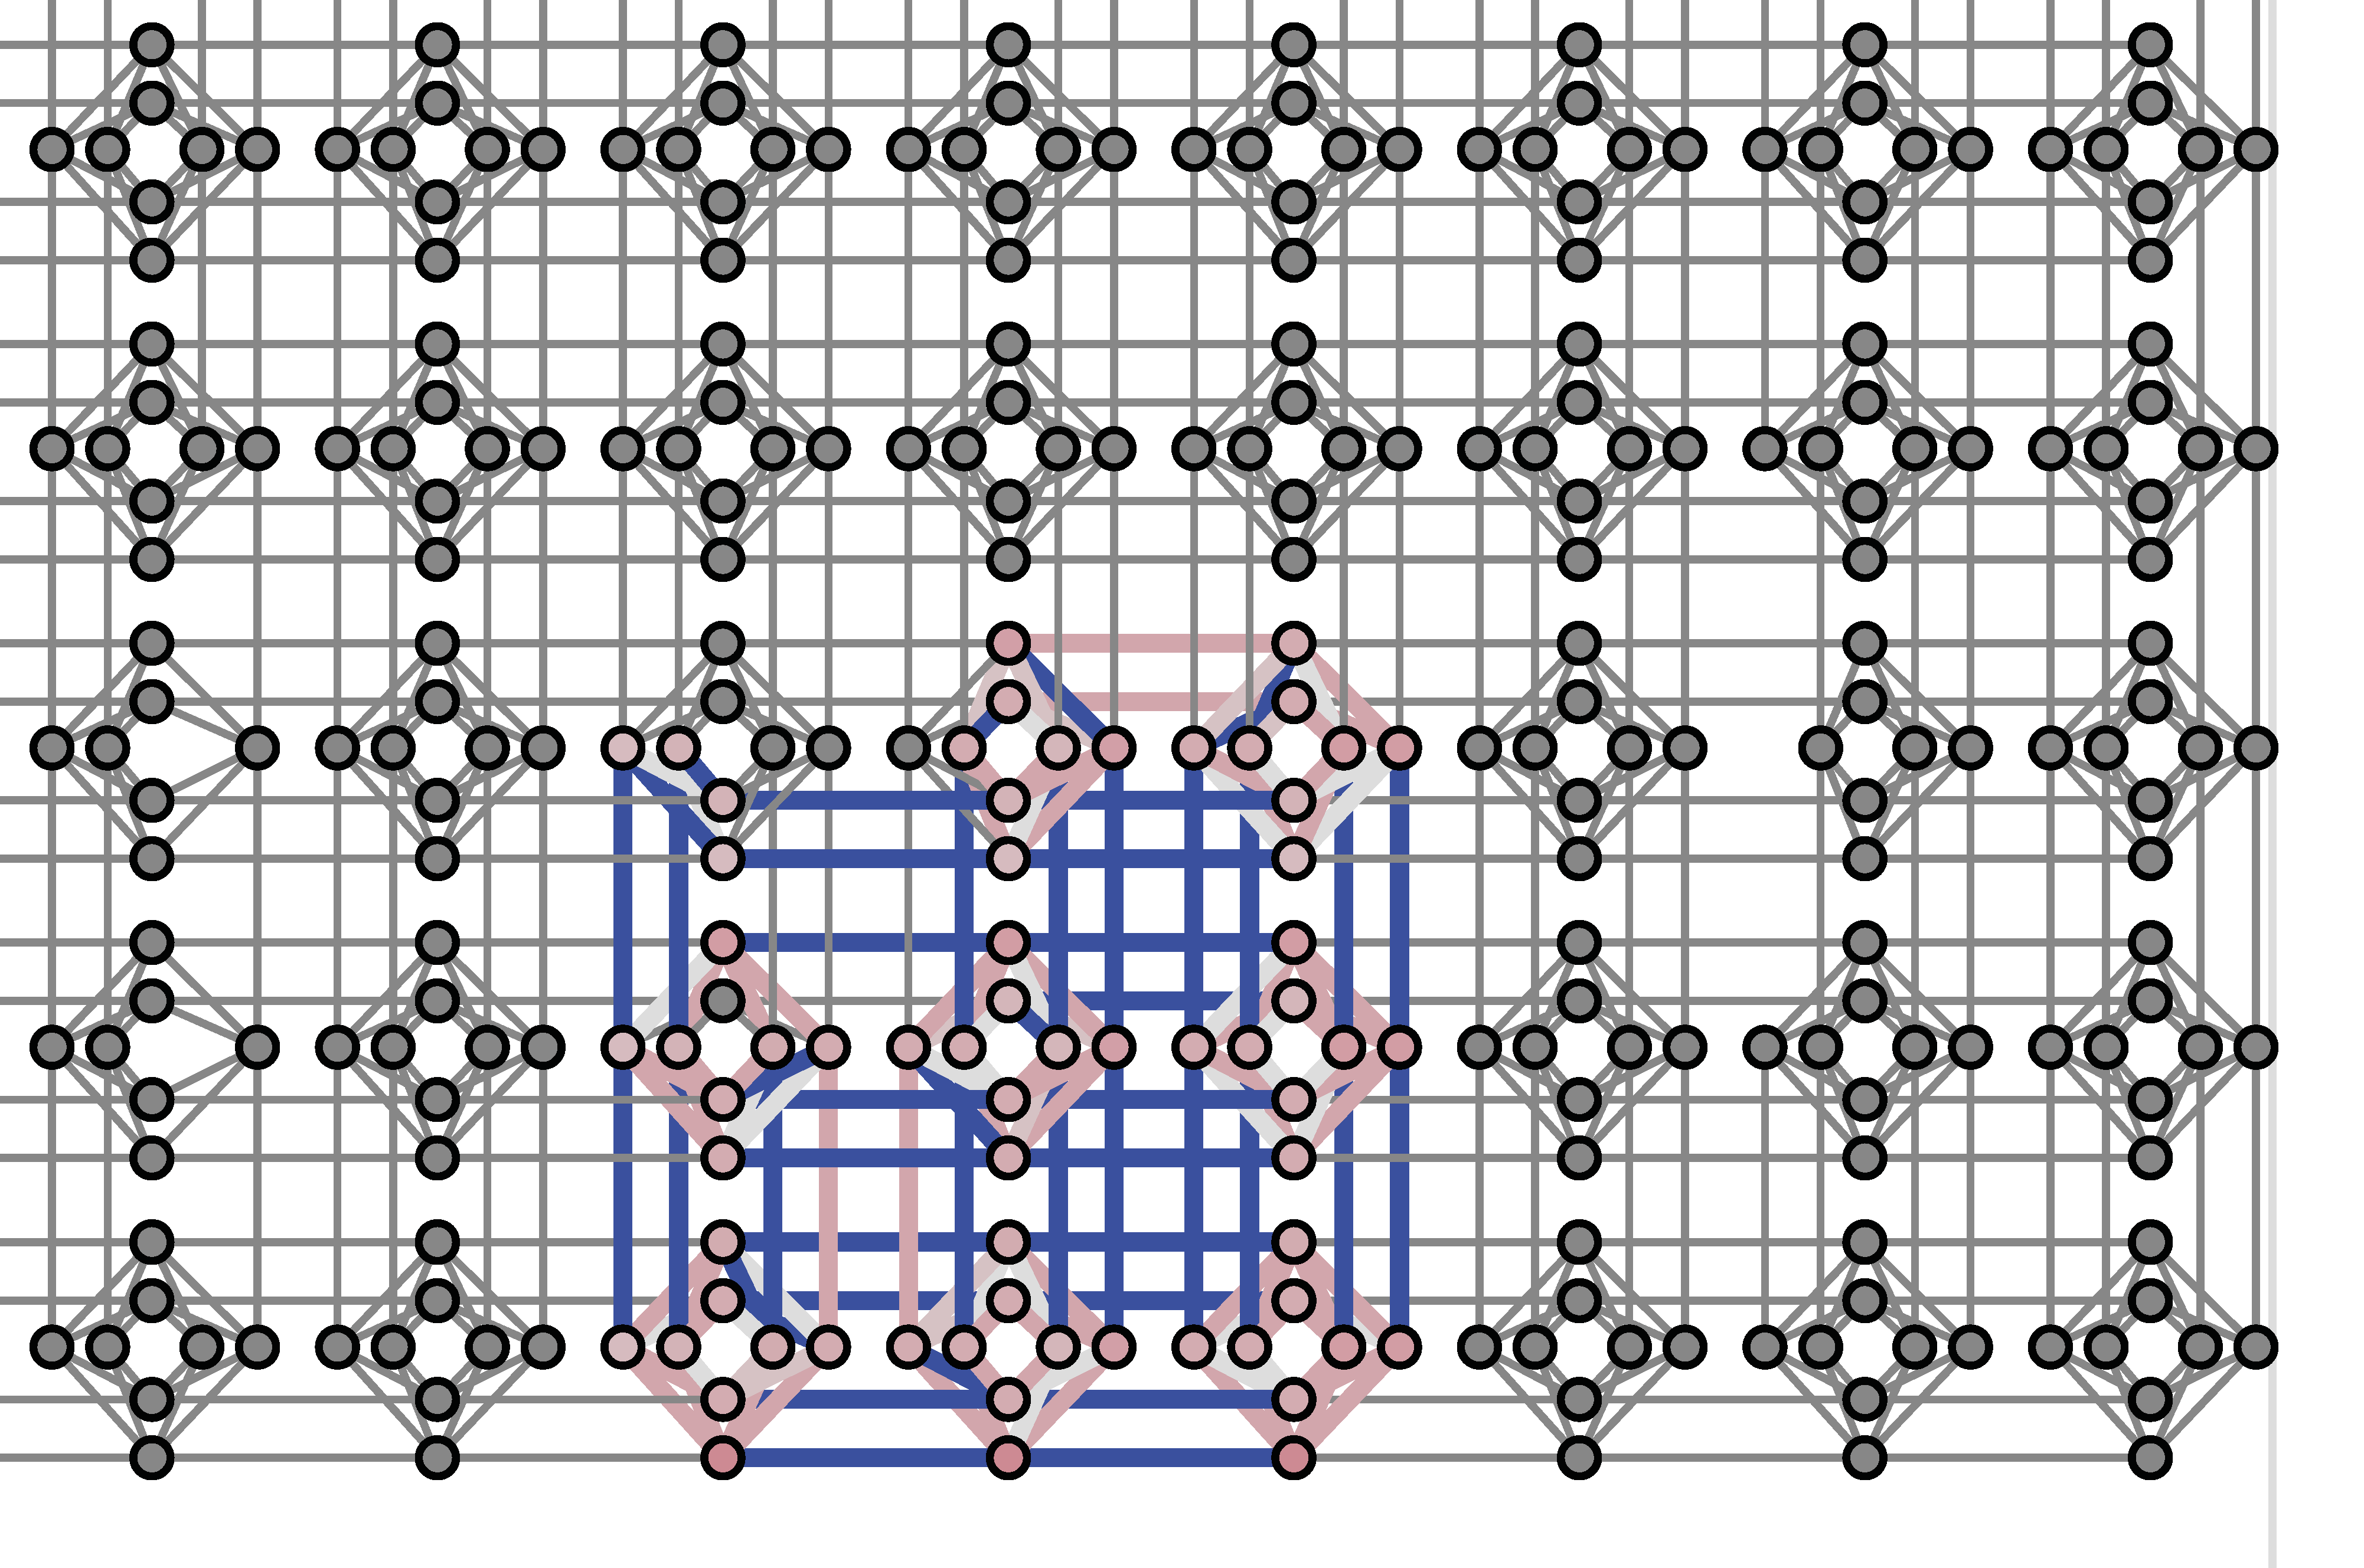
Was ist der Chimera-Graph?
Die möglichen Verschaltungswege zwischen den Qubits werden von dem Chimera-Graphen dargestellt. Jedes Qubit kann mit 6 anderen Qubits gekoppelt werden. Die Kombination mehrerer Kopplungen nennt sich Embedding und kommt auf Basis der Hamilton-Matrix zustande.
Chimera-Graph
Ausschnitt eines Chimera-Graphen
Embedding
Qubit
Koppler

Slide 4
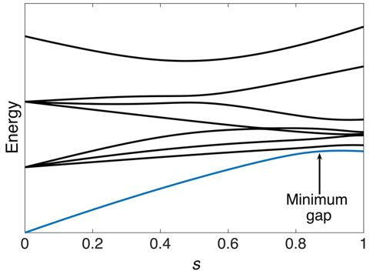
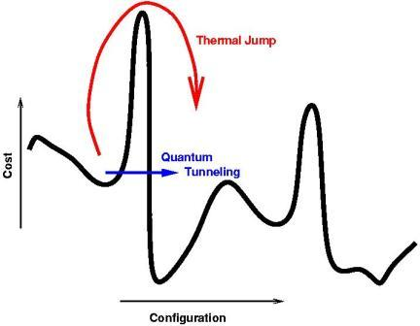
Was passiert während der Quantencomputer „rechnet“?
Ablauf eines Optimierungsdurchlaufs (Anneal):
Anfangs sind wegen des Initial-Hamiltonians alle Qubits in Superposition
Initial-Hamiltonian wird aus-, und der eigene Hamiltonian eingafadet
Daher: Qubits bleiben immer im Energieärmsten Zustand und können Berge in der Energielandschaft tunneln
Am Ende werden alle Werte der Qubits gemessen
Ein Anneal dauert ca. 20 Mikrosekunden
Initial-Hamiltonian
Eigener Hamiltonian
Kosten
Energieärmster Zustand
Energiesprung
Zeit
Kosten
tunneling
Situation

Slide 5
Wie entsteht die Hamilton-Matrix?
Zum Beispiel:
Felder A und B dürfen nicht gleichzeitig besetzt sein
Was ist die Hamilton-Matrix:
Um ein Optimierungsproblem auf einem Quantencomputer zu lösen, muss man es als Hamilton-Matrix formulieren, welche dann, multipliziert mit den Werten der Qubits, minimal ist, wenn das Problem gelöst ist. Auf Basis der Hamilton-Matrix wird das Embedding generiert.
 | A | B | C | D
A | -2 | 2 | 0 | 0
B | 0 | -2 | 0 | 0
C | 0 | 0 | -2 | 0
D | 0 | 0 | 0 | -2
A | B
C | D
-> an die Stelle B|A wird eine „Bestrafung“ von +2 angetragen

Slide 6
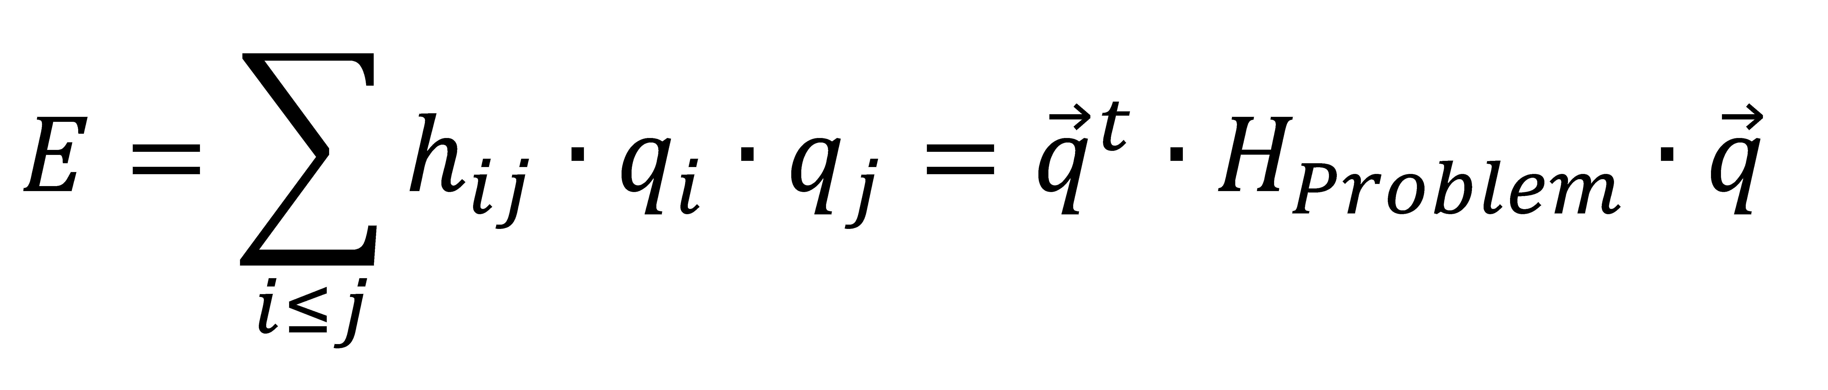
Was ist die Energie?
Situation:
Die Energie (Kosten) beschreibt immer, wie gut oder schlecht eine Situation ist. Um sie zu berechnen, muss man die Matrix mit den Werten der Felder multiplizieren.
Die Aufgabe, die sich uns jetzt stellt, besteht darin für jedes Problem diesen Hamiltonian zu finden.
1 | 1
0 | 1
0 | 1
1 | 1
Multipliziert mit der Matrix:
-2 | 2 | 0 | 0
0 | -2 | 0 | 0
0 | 0 | -2 | 0
0 | 0 | 0 | -2
-2 | 2 | 0 | 0
0 | -2 | 0 | 0
0 | 0 | -2 | 0
0 | 0 | 0 | -2
Ergibt die Kosten: -6
Optimales Ergebnis erreicht!
Ergibt die Kosten: -4

Slide 7

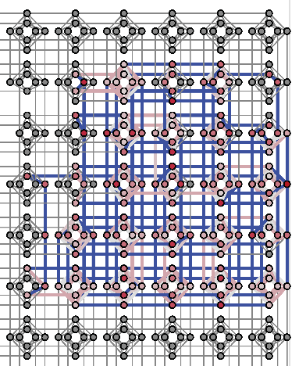
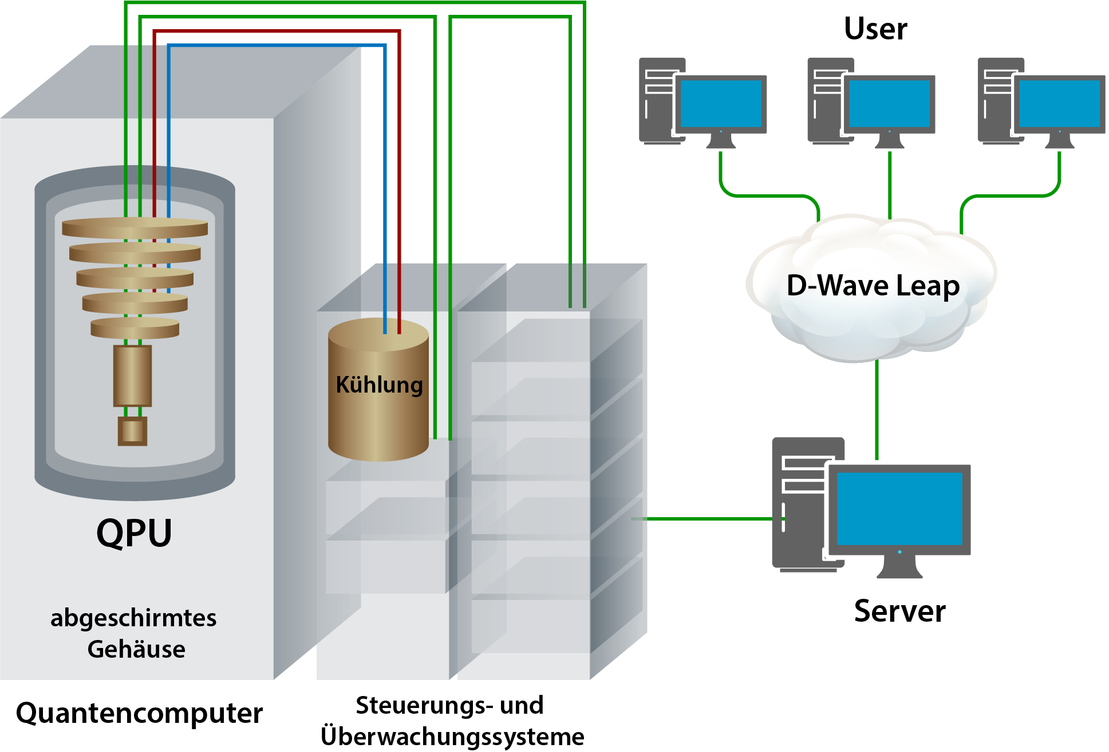
-10.000000 251 [0 0 0 0 1 0 0 1 0 0 1 0 0 0 0 0 0 0 1 0 0 1 0 0 0]
-10.000000 1 [0 1 0 0 0 0 0 0 1 0 1 0 0 0 0 0 0 1 0 0 0 0 0 0 1]
-10.000000 76 [1 0 0 0 0 0 0 0 1 0 0 1 0 0 0 0 0 0 0 1 0 0 1 0 0]
-10.000000 216 [1 0 0 0 0 0 0 1 0 0 0 0 0 0 1 0 1 0 0 0 0 0 0 1 0]
-10.000000 82 [0 0 1 0 0 0 0 0 0 1 0 1 0 0 0 0 0 0 1 0 1 0 0 0 0]
-10.000000 32 [0 1 0 0 0 0 0 0 0 1 0 0 1 0 0 1 0 0 0 0 0 0 0 1 0]
-10.000000 171 [0 0 0 1 0 0 1 0 0 0 0 0 0 0 1 0 0 1 0 0 1 0 0 0 0]
-10.000000 36 [0 0 0 1 0 1 0 0 0 0 0 0 1 0 0 0 0 0 0 1 0 1 0 0 0]
-10.000000 11 [0 0 0 0 1 0 1 0 0 0 0 0 0 1 0 1 0 0 0 0 0 0 1 0 0]
-10.000000 1 [0 0 1 0 0 0 0 0 0 1 0 1 0 0 0 0 0 0 1 0 1 0 0 0 0]
-8.000000 21 [0 0 0 0 1 0 0 1 0 0 1 0 0 0 0 0 0 0 0 0 0 0 0 1 0]
-8.000000 6 [0 0 0 0 1 0 0 1 0 0 1 0 0 0 0 0 0 0 1 0 0 0 0 1 0]
-8.000000 2 [0 0 0 1 0 0 0 0 0 0 1 0 0 0 0 0 0 1 0 0 0 0 0 0 1]
-8.000000 36 [1 0 0 0 0 0 0 1 0 0 0 0 0 0 1 0 0 0 0 0 0 0 0 1 0]
-8.000000 55 [0 0 0 0 1 0 0 1 0 0 1 0 0 0 0 0 0 0 1 0 0 0 0 0 0]
-8.000000 5 [0 0 0 0 1 0 0 1 0 0 1 0 0 0 0 0 0 0 0 0 0 1 0 1 0]
-8.000000 3 [0 0 0 0 1 0 0 1 0 0 1 0 0 0 0 0 0 0 1 0 0 1 0 1 0]
-8.000000 19 [0 0 0 0 1 0 0 1 0 0 1 0 0 0 0 0 0 0 0 0 0 1 0 0 0]
-8.000000 2 [1 0 0 0 0 0 0 1 0 1 0 0 0 0 0 0 1 0 0 0 0 0 0 1 0]
-8.000000 6 [1 0 0 0 0 0 0 0 0 1 0 1 0 0 0 0 0 0 0 0 0 0 1 0 0]
-8.000000 47 [0 0 0 0 1 0 0 1 0 0 0 0 0 0 0 0 0 0 1 0 0 1 0 0 0]
-8.000000 8 [1 0 0 0 0 0 0 1 0 0 0 0 0 0 1 0 0 0 0 0 0 1 0 1 0]
-8.000000 30 [1 0 0 0 0 0 0 0 1 0 0 1 0 0 0 0 0 0 0 0 0 0 1 0 0]
-2 | 2 | 2 | 2 | 2 | 2 | 0 | 0 | 2 | 0 | 2 | 0 | 2 | 0 | 0 | 2
0 | -2 | 2 | 2 | 2 | 2 | 2 | 0 | 0 | 2 | 0 | 2 | 0 | 2 | 0 | 0
0 | 0 | -2 | 2 | 0 | 2 | 2 | 2 | 2 | 0 | 2 | 0 | 0 | 0 | 2 | 0
0 | 0 | 0 | -2 | 0 | 0 | 2 | 2 | 0 | 2 | 0 | 2 | 2 | 0 | 0 | 2
0 | 0 | 0 | 0 | -2 | 2 | 2 | 2 | 2 | 2 | 0 | 0 | 2 | 0 | 2 | 0
0 | 0 | 0 | 0 | 0 | -2 | 2 | 2 | 2 | 2 | 2 | 0 | 0 | 2 | 0 | 2
0 | 0 | 0 | 0 | 0 | 0 | -2 | 2 | 0 | 2 | 2 | 2 | 2 | 0 | 2 | 0
0 | 0 | 0 | 0 | 0 | 0 | 0 | -2 | 0 | 0 | 2 | 2 | 0 | 2 | 0 | 2
0 | 0 | 0 | 0 | 0 | 0 | 0 | 0 | -2 | 2 | 2 | 2 | 2 | 2 | 0 | 0
0 | 0 | 0 | 0 | 0 | 0 | 0 | 0 | 0 | -2 | 2 | 2 | 2 | 2 | 2 | 0
0 | 0 | 0 | 0 | 0 | 0 | 0 | 0 | 0 | 0 | -2 | 2 | 0 | 2 | 2 | 2
0 | 0 | 0 | 0 | 0 | 0 | 0 | 0 | 0 | 0 | 0 | -2 | 0 | 0 | 2 | 2
0 | 0 | 0 | 0 | 0 | 0 | 0 | 0 | 0 | 0 | 0 | 0 | -2 | 2 | 2 | 2
0 | 0 | 0 | 0 | 0 | 0 | 0 | 0 | 0 | 0 | 0 | 0 | 0 | -2 | 2 | 2
0 | 0 | 0 | 0 | 0 | 0 | 0 | 0 | 0 | 0 | 0 | 0 | 0 | 0 | -2 | 2
0 | 0 | 0 | 0 | 0 | 0 | 0 | 0 | 0 | 0 | 0 | 0 | 0 | 0 | 0 | -2
Interaktion mit dem Quantencomputer
Ergebnisse
Rechenchip
QPU

Slide 8

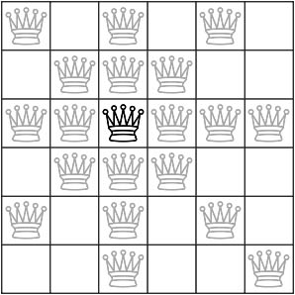
Das n-Damenproblem
Das n-Damenproblem ist ein Schachproblem, bei dem es darum geht, auf einem n x n Feld n Schachdamen (z.B. auf einem 6 x 6 Feld 6 Damen) so anzuordnen, dass sie sich gegenseitig nicht bedrohen.
Unsere Aufgabe war es, einen Hamiltonian aufzustellen, der dann minimal ist, wenn das Problem gelöst ist!
Erlaubte Züge einer Schachdame:
Daraus folgen drei Regeln:
Pro Spalte höchstens eine Dame
Pro Reihe höchstens eine Dame
Pro Diagonale höchstens eine Dame

Slide 9
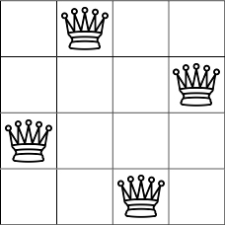
Hamiltonian des 4-Damenproblems
-2 | 2 | 2 | 2 | 2 | 2 | 0 | 0 | 2 | 0 | 2 | 0 | 2 | 0 | 0 | 2
0 | -2 | 2 | 2 | 2 | 2 | 2 | 0 | 0 | 2 | 0 | 2 | 0 | 2 | 0 | 0
0 | 0 | -2 | 2 | 0 | 2 | 2 | 2 | 2 | 0 | 2 | 0 | 0 | 0 | 2 | 0
0 | 0 | 0 | -2 | 0 | 0 | 2 | 2 | 0 | 2 | 0 | 2 | 2 | 0 | 0 | 2
0 | 0 | 0 | 0 | -2 | 2 | 2 | 2 | 2 | 2 | 0 | 0 | 2 | 0 | 2 | 0
0 | 0 | 0 | 0 | 0 | -2 | 2 | 2 | 2 | 2 | 2 | 0 | 0 | 2 | 0 | 2
0 | 0 | 0 | 0 | 0 | 0 | -2 | 2 | 0 | 2 | 2 | 2 | 2 | 0 | 2 | 0
0 | 0 | 0 | 0 | 0 | 0 | 0 | -2 | 0 | 0 | 2 | 2 | 0 | 2 | 0 | 2
0 | 0 | 0 | 0 | 0 | 0 | 0 | 0 | -2 | 2 | 2 | 2 | 2 | 2 | 0 | 0
0 | 0 | 0 | 0 | 0 | 0 | 0 | 0 | 0 | -2 | 2 | 2 | 2 | 2 | 2 | 0
0 | 0 | 0 | 0 | 0 | 0 | 0 | 0 | 0 | 0 | -2 | 2 | 0 | 2 | 2 | 2
0 | 0 | 0 | 0 | 0 | 0 | 0 | 0 | 0 | 0 | 0 | -2 | 0 | 0 | 2 | 2
0 | 0 | 0 | 0 | 0 | 0 | 0 | 0 | 0 | 0 | 0 | 0 | -2 | 2 | 2 | 2
0 | 0 | 0 | 0 | 0 | 0 | 0 | 0 | 0 | 0 | 0 | 0 | 0 | -2 | 2 | 2
0 | 0 | 0 | 0 | 0 | 0 | 0 | 0 | 0 | 0 | 0 | 0 | 0 | 0 | -2 | 2
0 | 0 | 0 | 0 | 0 | 0 | 0 | 0 | 0 | 0 | 0 | 0 | 0 | 0 | 0 | -2

Slide 10

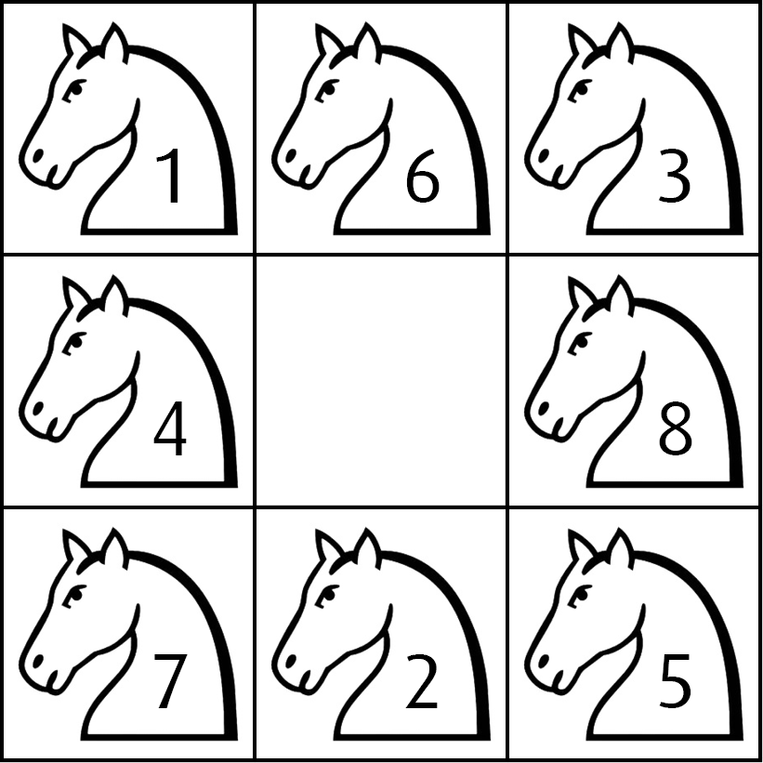
Das Springerwegproblem
Beim Springerproblem geht es darum, auf einem Schachfeld eine Route zu finden, bei der ein Springer jedes Feld genau einmal besucht.
Bei diesem Problem haben wir uns die Züge des Springers als Zeitebenen vorgestellt, die untereinander angeordnet sind. So „hüpft“ der Springer von einer in die nächste Zeitebene.
Position 1
Der Springerzug:
Mögliche Lösung
Position 2
Regeln:
Pro Zeitebene nur ein Springer
Kein Feld darf doppelt betreten werden
Position 3
In übereinanderliegenden Zeitebenen nur Springerzug

Slide 11
Hamiltonian des Springerproblems
 | b
d |  | e
 | g
a | b | c
d |  | e
f | g | h
Da die Anzahl der aktuell verfügbaren Qubits noch nicht reicht, um das Problem zu lösen, konnten wir das 3 x 3 Feld pro Ebene auf ein 2 x 2 Feld verkleinern. Bedingt durch den Springerzug wechselt der Springer bei jedem Zug die Feldfarbe. Da außerdem das mittlere Feld nicht erreicht werden kann, bleiben nur noch 4 statt 9 Qubits pro Zeitebene!
b | d
e | g
a |  | c
f |  | h
a | b | c
d |  | e
f | g | h
a | c
f | h

Slide 12
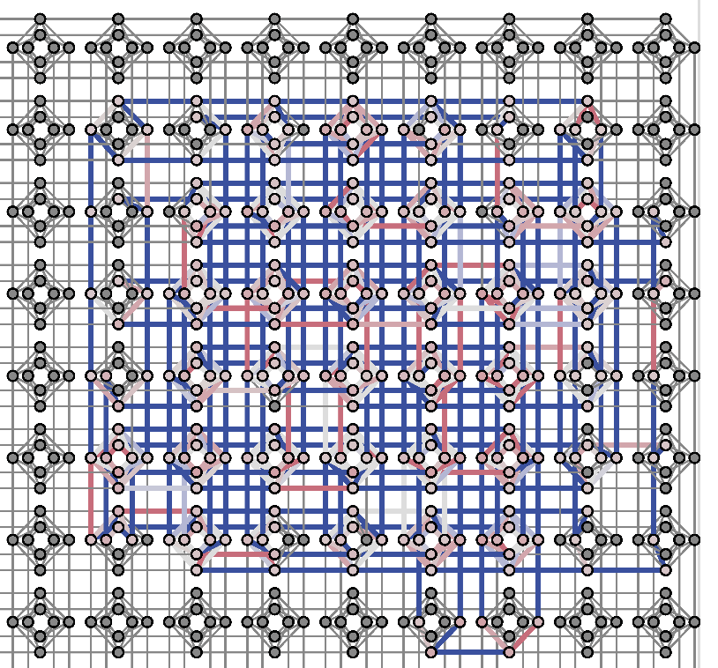
0 | 2 | 2 | 2 | 2 | 2 | 2 | 2 | 4 | 0 | 0 | 0 | 0 | 0 | 2 | 0 | 4 | 0 | 0 | 0 | 0 | 2 | 0 | 0 | 4 | 0 | 0 | 0 | 2 | 0 | 0 | 0 | 4 | 0 | 0 | 2 | 0 | 0 | 0 | 0 | 4 | 0 | 2 | 0 | 0 | 0 | 0 | 0 | 4
0 | -2 | 2 | 2 | 2 | 2 | 2 | 2 | 2 | 2 | 0 | 0 | 0 | 0 | 0 | 2 | 0 | 2 | 0 | 0 | 0 | 0 | 2 | 0 | 0 | 2 | 0 | 0 | 0 | 2 | 0 | 0 | 0 | 2 | 0 | 0 | 2 | 0 | 0 | 0 | 0 | 2 | 0 | 2 | 0 | 0 | 0 | 0 | 0
0 | 0 | -2 | 2 | 2 | 2 | 2 | 0 | 2 | 2 | 2 | 0 | 0 | 0 | 2 | 0 | 2 | 0 | 2 | 0 | 0 | 0 | 0 | 2 | 0 | 0 | 2 | 0 | 0 | 0 | 2 | 0 | 0 | 0 | 2 | 0 | 0 | 2 | 0 | 0 | 0 | 0 | 0 | 0 | 2 | 0 | 0 | 0 | 0
0 | 0 | 0 | -2 | 2 | 2 | 2 | 0 | 0 | 2 | 2 | 2 | 0 | 0 | 0 | 2 | 0 | 2 | 0 | 2 | 0 | 2 | 0 | 0 | 2 | 0 | 0 | 2 | 0 | 0 | 0 | 2 | 0 | 0 | 0 | 0 | 0 | 0 | 2 | 0 | 0 | 0 | 0 | 0 | 0 | 2 | 0 | 0 | 0
0 | 0 | 0 | 0 | -2 | 2 | 2 | 0 | 0 | 0 | 2 | 2 | 2 | 0 | 0 | 0 | 2 | 0 | 2 | 0 | 2 | 0 | 2 | 0 | 0 | 2 | 0 | 0 | 2 | 0 | 0 | 0 | 2 | 0 | 0 | 0 | 0 | 0 | 0 | 2 | 0 | 0 | 0 | 0 | 0 | 0 | 2 | 0 | 0
0 | 0 | 0 | 0 | 0 | -2 | 2 | 0 | 0 | 0 | 0 | 2 | 2 | 2 | 0 | 0 | 0 | 2 | 0 | 2 | 0 | 0 | 0 | 2 | 0 | 0 | 2 | 0 | 0 | 2 | 0 | 0 | 0 | 2 | 0 | 2 | 0 | 0 | 0 | 0 | 2 | 0 | 0 | 0 | 0 | 0 | 0 | 2 | 0
0 | 0 | 0 | 0 | 0 | 0 | -2 | 0 | 0 | 0 | 0 | 0 | 0 | 2 | 0 | 0 | 0 | 0 | 0 | 0 | 2 | 0 | 0 | 0 | 0 | 0 | 0 | 2 | 0 | 0 | 0 | 0 | 0 | 0 | 2 | 0 | 0 | 0 | 0 | 0 | 0 | 2 | 0 | 0 | 0 | 0 | 0 | 0 | 2
0 | 0 | 0 | 0 | 0 | 0 | 0 | -2 | 2 | 2 | 2 | 2 | 2 | 2 | 2 | 2 | 0 | 0 | 0 | 0 | 0 | 2 | 0 | 2 | 0 | 0 | 0 | 0 | 2 | 0 | 0 | 2 | 0 | 0 | 0 | 2 | 0 | 0 | 0 | 2 | 0 | 0 | 2 | 0 | 0 | 0 | 0 | 2 | 0
0 | 0 | 0 | 0 | 0 | 0 | 0 | 0 | 0 | 2 | 2 | 2 | 2 | 2 | 2 | 2 | 4 | 0 | 0 | 0 | 0 | 0 | 2 | 0 | 4 | 0 | 0 | 0 | 0 | 2 | 0 | 0 | 4 | 0 | 0 | 0 | 2 | 0 | 0 | 0 | 4 | 0 | 0 | 2 | 0 | 0 | 0 | 0 | 4
0 | 0 | 0 | 0 | 0 | 0 | 0 | 0 | 0 | -2 | 2 | 2 | 2 | 2 | 0 | 2 | 2 | 2 | 0 | 0 | 0 | 2 | 0 | 2 | 0 | 2 | 0 | 0 | 0 | 0 | 2 | 0 | 0 | 2 | 0 | 0 | 0 | 2 | 0 | 0 | 0 | 2 | 0 | 0 | 2 | 0 | 0 | 0 | 0
0 | 0 | 0 | 0 | 0 | 0 | 0 | 0 | 0 | 0 | -2 | 2 | 2 | 2 | 0 | 0 | 2 | 2 | 2 | 0 | 0 | 0 | 2 | 0 | 2 | 0 | 2 | 0 | 2 | 0 | 0 | 2 | 0 | 0 | 2 | 0 | 0 | 0 | 2 | 0 | 0 | 0 | 0 | 0 | 0 | 2 | 0 | 0 | 0
0 | 0 | 0 | 0 | 0 | 0 | 0 | 0 | 0 | 0 | 0 | -2 | 2 | 2 | 0 | 0 | 0 | 2 | 2 | 2 | 0 | 0 | 0 | 2 | 0 | 2 | 0 | 2 | 0 | 2 | 0 | 0 | 2 | 0 | 0 | 2 | 0 | 0 | 0 | 2 | 0 | 0 | 0 | 0 | 0 | 0 | 2 | 0 | 0
0 | 0 | 0 | 0 | 0 | 0 | 0 | 0 | 0 | 0 | 0 | 0 | -2 | 2 | 0 | 0 | 0 | 0 | 2 | 2 | 2 | 0 | 0 | 0 | 2 | 0 | 2 | 0 | 0 | 0 | 2 | 0 | 0 | 2 | 0 | 0 | 2 | 0 | 0 | 0 | 2 | 0 | 2 | 0 | 0 | 0 | 0 | 2 | 0
0 | 0 | 0 | 0 | 0 | 0 | 0 | 0 | 0 | 0 | 0 | 0 | 0 | -2 | 0 | 0 | 0 | 0 | 0 | 0 | 2 | 0 | 0 | 0 | 0 | 0 | 0 | 2 | 0 | 0 | 0 | 0 | 0 | 0 | 2 | 0 | 0 | 0 | 0 | 0 | 0 | 2 | 0 | 0 | 0 | 0 | 0 | 0 | 2
0 | 0 | 0 | 0 | 0 | 0 | 0 | 0 | 0 | 0 | 0 | 0 | 0 | 0 | -2 | 2 | 2 | 2 | 2 | 2 | 2 | 2 | 2 | 0 | 0 | 0 | 0 | 0 | 2 | 0 | 2 | 0 | 0 | 0 | 0 | 2 | 0 | 0 | 2 | 0 | 0 | 0 | 2 | 0 | 0 | 0 | 2 | 0 | 0
0 | 0 | 0 | 0 | 0 | 0 | 0 | 0 | 0 | 0 | 0 | 0 | 0 | 0 | 0 | -2 | 2 | 2 | 2 | 2 | 2 | 2 | 2 | 2 | 0 | 0 | 0 | 0 | 0 | 2 | 0 | 2 | 0 | 0 | 0 | 0 | 2 | 0 | 0 | 2 | 0 | 0 | 0 | 2 | 0 | 0 | 0 | 2 | 0
0 | 0 | 0 | 0 | 0 | 0 | 0 | 0 | 0 | 0 | 0 | 0 | 0 | 0 | 0 | 0 | 0 | 2 | 2 | 2 | 2 | 0 | 2 | 2 | 4 | 0 | 0 | 0 | 2 | 0 | 2 | 0 | 4 | 0 | 0 | 0 | 0 | 2 | 0 | 0 | 4 | 0 | 0 | 0 | 2 | 0 | 0 | 0 | 4
0 | 0 | 0 | 0 | 0 | 0 | 0 | 0 | 0 | 0 | 0 | 0 | 0 | 0 | 0 | 0 | 0 | -2 | 2 | 2 | 2 | 0 | 0 | 2 | 2 | 2 | 0 | 0 | 0 | 2 | 0 | 2 | 0 | 2 | 0 | 2 | 0 | 0 | 2 | 0 | 0 | 2 | 0 | 0 | 0 | 2 | 0 | 0 | 0
0 | 0 | 0 | 0 | 0 | 0 | 0 | 0 | 0 | 0 | 0 | 0 | 0 | 0 | 0 | 0 | 0 | 0 | -2 | 2 | 2 | 0 | 0 | 0 | 2 | 2 | 2 | 0 | 0 | 0 | 2 | 0 | 2 | 0 | 2 | 0 | 2 | 0 | 0 | 2 | 0 | 0 | 2 | 0 | 0 | 0 | 2 | 0 | 0
0 | 0 | 0 | 0 | 0 | 0 | 0 | 0 | 0 | 0 | 0 | 0 | 0 | 0 | 0 | 0 | 0 | 0 | 0 | -2 | 2 | 0 | 0 | 0 | 0 | 2 | 2 | 2 | 0 | 0 | 0 | 2 | 0 | 2 | 0 | 0 | 0 | 2 | 0 | 0 | 2 | 0 | 0 | 2 | 0 | 0 | 0 | 2 | 0
0 | 0 | 0 | 0 | 0 | 0 | 0 | 0 | 0 | 0 | 0 | 0 | 0 | 0 | 0 | 0 | 0 | 0 | 0 | 0 | -2 | 0 | 0 | 0 | 0 | 0 | 0 | 2 | 0 | 0 | 0 | 0 | 0 | 0 | 2 | 0 | 0 | 0 | 0 | 0 | 0 | 2 | 0 | 0 | 0 | 0 | 0 | 0 | 2
0 | 0 | 0 | 0 | 0 | 0 | 0 | 0 | 0 | 0 | 0 | 0 | 0 | 0 | 0 | 0 | 0 | 0 | 0 | 0 | 0 | -2 | 2 | 2 | 2 | 2 | 2 | 2 | 2 | 2 | 0 | 0 | 0 | 0 | 0 | 2 | 0 | 2 | 0 | 0 | 0 | 0 | 2 | 0 | 0 | 2 | 0 | 0 | 0
0 | 0 | 0 | 0 | 0 | 0 | 0 | 0 | 0 | 0 | 0 | 0 | 0 | 0 | 0 | 0 | 0 | 0 | 0 | 0 | 0 | 0 | -2 | 2 | 2 | 2 | 2 | 2 | 2 | 2 | 2 | 0 | 0 | 0 | 0 | 0 | 2 | 0 | 2 | 0 | 0 | 0 | 0 | 2 | 0 | 0 | 2 | 0 | 0
0 | 0 | 0 | 0 | 0 | 0 | 0 | 0 | 0 | 0 | 0 | 0 | 0 | 0 | 0 | 0 | 0 | 0 | 0 | 0 | 0 | 0 | 0 | -2 | 2 | 2 | 2 | 2 | 0 | 2 | 2 | 2 | 0 | 0 | 0 | 2 | 0 | 2 | 0 | 2 | 0 | 0 | 0 | 0 | 2 | 0 | 0 | 2 | 0
0 | 0 | 0 | 0 | 0 | 0 | 0 | 0 | 0 | 0 | 0 | 0 | 0 | 0 | 0 | 0 | 0 | 0 | 0 | 0 | 0 | 0 | 0 | 0 | 0 | 2 | 2 | 2 | 0 | 0 | 2 | 2 | 4 | 0 | 0 | 0 | 2 | 0 | 2 | 0 | 4 | 0 | 2 | 0 | 0 | 2 | 0 | 0 | 4
0 | 0 | 0 | 0 | 0 | 0 | 0 | 0 | 0 | 0 | 0 | 0 | 0 | 0 | 0 | 0 | 0 | 0 | 0 | 0 | 0 | 0 | 0 | 0 | 0 | -2 | 2 | 2 | 0 | 0 | 0 | 2 | 2 | 2 | 0 | 0 | 0 | 2 | 0 | 2 | 0 | 2 | 0 | 2 | 0 | 0 | 2 | 0 | 0
0 | 0 | 0 | 0 | 0 | 0 | 0 | 0 | 0 | 0 | 0 | 0 | 0 | 0 | 0 | 0 | 0 | 0 | 0 | 0 | 0 | 0 | 0 | 0 | 0 | 0 | -2 | 2 | 0 | 0 | 0 | 0 | 2 | 2 | 2 | 0 | 0 | 0 | 2 | 0 | 2 | 0 | 0 | 0 | 2 | 0 | 0 | 2 | 0
0 | 0 | 0 | 0 | 0 | 0 | 0 | 0 | 0 | 0 | 0 | 0 | 0 | 0 | 0 | 0 | 0 | 0 | 0 | 0 | 0 | 0 | 0 | 0 | 0 | 0 | 0 | -2 | 0 | 0 | 0 | 0 | 0 | 0 | 2 | 0 | 0 | 0 | 0 | 0 | 0 | 2 | 0 | 0 | 0 | 0 | 0 | 0 | 2
0 | 0 | 0 | 0 | 0 | 0 | 0 | 0 | 0 | 0 | 0 | 0 | 0 | 0 | 0 | 0 | 0 | 0 | 0 | 0 | 0 | 0 | 0 | 0 | 0 | 0 | 0 | 0 | -2 | 2 | 2 | 2 | 2 | 2 | 2 | 2 | 2 | 0 | 0 | 0 | 0 | 0 | 2 | 0 | 2 | 0 | 0 | 0 | 0
0 | 0 | 0 | 0 | 0 | 0 | 0 | 0 | 0 | 0 | 0 | 0 | 0 | 0 | 0 | 0 | 0 | 0 | 0 | 0 | 0 | 0 | 0 | 0 | 0 | 0 | 0 | 0 | 0 | -2 | 2 | 2 | 2 | 2 | 2 | 2 | 2 | 2 | 0 | 0 | 0 | 0 | 0 | 2 | 0 | 2 | 0 | 0 | 0
0 | 0 | 0 | 0 | 0 | 0 | 0 | 0 | 0 | 0 | 0 | 0 | 0 | 0 | 0 | 0 | 0 | 0 | 0 | 0 | 0 | 0 | 0 | 0 | 0 | 0 | 0 | 0 | 0 | 0 | -2 | 2 | 2 | 2 | 2 | 0 | 2 | 2 | 2 | 0 | 0 | 0 | 2 | 0 | 2 | 0 | 2 | 0 | 0
0 | 0 | 0 | 0 | 0 | 0 | 0 | 0 | 0 | 0 | 0 | 0 | 0 | 0 | 0 | 0 | 0 | 0 | 0 | 0 | 0 | 0 | 0 | 0 | 0 | 0 | 0 | 0 | 0 | 0 | 0 | -2 | 2 | 2 | 2 | 0 | 0 | 2 | 2 | 2 | 0 | 0 | 0 | 2 | 0 | 2 | 0 | 2 | 0
0 | 0 | 0 | 0 | 0 | 0 | 0 | 0 | 0 | 0 | 0 | 0 | 0 | 0 | 0 | 0 | 0 | 0 | 0 | 0 | 0 | 0 | 0 | 0 | 0 | 0 | 0 | 0 | 0 | 0 | 0 | 0 | 0 | 2 | 2 | 0 | 0 | 0 | 2 | 2 | 4 | 0 | 0 | 0 | 2 | 0 | 2 | 0 | 4
0 | 0 | 0 | 0 | 0 | 0 | 0 | 0 | 0 | 0 | 0 | 0 | 0 | 0 | 0 | 0 | 0 | 0 | 0 | 0 | 0 | 0 | 0 | 0 | 0 | 0 | 0 | 0 | 0 | 0 | 0 | 0 | 0 | -2 | 2 | 0 | 0 | 0 | 0 | 2 | 2 | 2 | 0 | 0 | 0 | 2 | 0 | 2 | 0
0 | 0 | 0 | 0 | 0 | 0 | 0 | 0 | 0 | 0 | 0 | 0 | 0 | 0 | 0 | 0 | 0 | 0 | 0 | 0 | 0 | 0 | 0 | 0 | 0 | 0 | 0 | 0 | 0 | 0 | 0 | 0 | 0 | 0 | -2 | 0 | 0 | 0 | 0 | 0 | 0 | 2 | 0 | 0 | 0 | 0 | 0 | 0 | 2
0 | 0 | 0 | 0 | 0 | 0 | 0 | 0 | 0 | 0 | 0 | 0 | 0 | 0 | 0 | 0 | 0 | 0 | 0 | 0 | 0 | 0 | 0 | 0 | 0 | 0 | 0 | 0 | 0 | 0 | 0 | 0 | 0 | 0 | 0 | -2 | 2 | 2 | 2 | 2 | 2 | 2 | 2 | 2 | 0 | 0 | 0 | 0 | 0
0 | 0 | 0 | 0 | 0 | 0 | 0 | 0 | 0 | 0 | 0 | 0 | 0 | 0 | 0 | 0 | 0 | 0 | 0 | 0 | 0 | 0 | 0 | 0 | 0 | 0 | 0 | 0 | 0 | 0 | 0 | 0 | 0 | 0 | 0 | 0 | -2 | 2 | 2 | 2 | 2 | 2 | 2 | 2 | 2 | 0 | 0 | 0 | 0
0 | 0 | 0 | 0 | 0 | 0 | 0 | 0 | 0 | 0 | 0 | 0 | 0 | 0 | 0 | 0 | 0 | 0 | 0 | 0 | 0 | 0 | 0 | 0 | 0 | 0 | 0 | 0 | 0 | 0 | 0 | 0 | 0 | 0 | 0 | 0 | 0 | -2 | 2 | 2 | 2 | 2 | 0 | 2 | 2 | 2 | 0 | 0 | 0
0 | 0 | 0 | 0 | 0 | 0 | 0 | 0 | 0 | 0 | 0 | 0 | 0 | 0 | 0 | 0 | 0 | 0 | 0 | 0 | 0 | 0 | 0 | 0 | 0 | 0 | 0 | 0 | 0 | 0 | 0 | 0 | 0 | 0 | 0 | 0 | 0 | 0 | -2 | 2 | 2 | 2 | 0 | 0 | 2 | 2 | 2 | 0 | 0
0 | 0 | 0 | 0 | 0 | 0 | 0 | 0 | 0 | 0 | 0 | 0 | 0 | 0 | 0 | 0 | 0 | 0 | 0 | 0 | 0 | 0 | 0 | 0 | 0 | 0 | 0 | 0 | 0 | 0 | 0 | 0 | 0 | 0 | 0 | 0 | 0 | 0 | 0 | -2 | 2 | 2 | 0 | 0 | 0 | 2 | 2 | 2 | 0
0 | 0 | 0 | 0 | 0 | 0 | 0 | 0 | 0 | 0 | 0 | 0 | 0 | 0 | 0 | 0 | 0 | 0 | 0 | 0 | 0 | 0 | 0 | 0 | 0 | 0 | 0 | 0 | 0 | 0 | 0 | 0 | 0 | 0 | 0 | 0 | 0 | 0 | 0 | 0 | 0 | 2 | 0 | 0 | 0 | 0 | 2 | 2 | 4
0 | 0 | 0 | 0 | 0 | 0 | 0 | 0 | 0 | 0 | 0 | 0 | 0 | 0 | 0 | 0 | 0 | 0 | 0 | 0 | 0 | 0 | 0 | 0 | 0 | 0 | 0 | 0 | 0 | 0 | 0 | 0 | 0 | 0 | 0 | 0 | 0 | 0 | 0 | 0 | 0 | -2 | 0 | 0 | 0 | 0 | 0 | 0 | 2
0 | 0 | 0 | 0 | 0 | 0 | 0 | 0 | 0 | 0 | 0 | 0 | 0 | 0 | 0 | 0 | 0 | 0 | 0 | 0 | 0 | 0 | 0 | 0 | 0 | 0 | 0 | 0 | 0 | 0 | 0 | 0 | 0 | 0 | 0 | 0 | 0 | 0 | 0 | 0 | 0 | 0 | -2 | 2 | 2 | 2 | 2 | 2 | 2
0 | 0 | 0 | 0 | 0 | 0 | 0 | 0 | 0 | 0 | 0 | 0 | 0 | 0 | 0 | 0 | 0 | 0 | 0 | 0 | 0 | 0 | 0 | 0 | 0 | 0 | 0 | 0 | 0 | 0 | 0 | 0 | 0 | 0 | 0 | 0 | 0 | 0 | 0 | 0 | 0 | 0 | 0 | -2 | 2 | 2 | 2 | 2 | 2
0 | 0 | 0 | 0 | 0 | 0 | 0 | 0 | 0 | 0 | 0 | 0 | 0 | 0 | 0 | 0 | 0 | 0 | 0 | 0 | 0 | 0 | 0 | 0 | 0 | 0 | 0 | 0 | 0 | 0 | 0 | 0 | 0 | 0 | 0 | 0 | 0 | 0 | 0 | 0 | 0 | 0 | 0 | 0 | -2 | 2 | 2 | 2 | 2
0 | 0 | 0 | 0 | 0 | 0 | 0 | 0 | 0 | 0 | 0 | 0 | 0 | 0 | 0 | 0 | 0 | 0 | 0 | 0 | 0 | 0 | 0 | 0 | 0 | 0 | 0 | 0 | 0 | 0 | 0 | 0 | 0 | 0 | 0 | 0 | 0 | 0 | 0 | 0 | 0 | 0 | 0 | 0 | 0 | -2 | 2 | 2 | 2
0 | 0 | 0 | 0 | 0 | 0 | 0 | 0 | 0 | 0 | 0 | 0 | 0 | 0 | 0 | 0 | 0 | 0 | 0 | 0 | 0 | 0 | 0 | 0 | 0 | 0 | 0 | 0 | 0 | 0 | 0 | 0 | 0 | 0 | 0 | 0 | 0 | 0 | 0 | 0 | 0 | 0 | 0 | 0 | 0 | 0 | -2 | 2 | 2
0 | 0 | 0 | 0 | 0 | 0 | 0 | 0 | 0 | 0 | 0 | 0 | 0 | 0 | 0 | 0 | 0 | 0 | 0 | 0 | 0 | 0 | 0 | 0 | 0 | 0 | 0 | 0 | 0 | 0 | 0 | 0 | 0 | 0 | 0 | 0 | 0 | 0 | 0 | 0 | 0 | 0 | 0 | 0 | 0 | 0 | 0 | -2 | 2
0 | 0 | 0 | 0 | 0 | 0 | 0 | 0 | 0 | 0 | 0 | 0 | 0 | 0 | 0 | 0 | 0 | 0 | 0 | 0 | 0 | 0 | 0 | 0 | 0 | 0 | 0 | 0 | 0 | 0 | 0 | 0 | 0 | 0 | 0 | 0 | 0 | 0 | 0 | 0 | 0 | 0 | 0 | 0 | 0 | 0 | 0 | 0 | 0
Hamilton-Matrix des vereinfachten Springerproblems

Slide 13
Das Sudoku
Was ist ein Sudoku:
Ein Sudoku besteht aus 9 x 9 Feldern, welche in kleinere 3 x 3 Feld-Bereiche unterteilt sind. In jeder Spalte, jeder Zeile und jedem 3 x 3 Bereich müssen die Zahlen von 1-9 genau einmal vorkommen. In unserem Fall haben wir zuerst eine abgewandelte Form, das 4 x 4 Sudoku behandelt. Außerdem sind bei einem Sudoku immer einige Zahlen vorgegeben, bei denen es allerdings nur eine Lösung gibt.
3
 |  | 3 | 4
3
4 |  | 1
 | 1
3
3
2
3
3
Regeln:
Beispiel eines 4 x 4 Sudokus mit vorgegebenen Werten
- Pro Reihe jede Zahl nur einmal
- Pro Spalte jede Zahl nur einmal
- Pro 2 x 2 Feld jede Zahl nur einmal

Slide 14
1
Bisher gab es bei unseren Problemen für jedes Feld nur zwei Möglichkeiten: besetzt oder nicht besetzt! Nun gibt es jedoch pro Feld nicht nur zwei, sondern 9 Möglichkeiten.
Daher haben wir das Schachfeld als 3-Dimensionales 9 x 9 x 9 Feld behandelt, bei welchem die einzelnen Zahlen jeweils von einem Feld dargestellt werden.
1 2
3 4
1 2
3 4
1 2
3 4
1 2
3 4
1 2
3 4
4
3
1
2
1
1 2
3 4
1 2
3 4
1 2
3 4
1 2
3 4
1 2
3 4
1 2
3 4
1 2
3 4
1 2
3 4
1 2
3 4
1 2
3 4
1 2
3 4
1 2
3 4

Slide 15
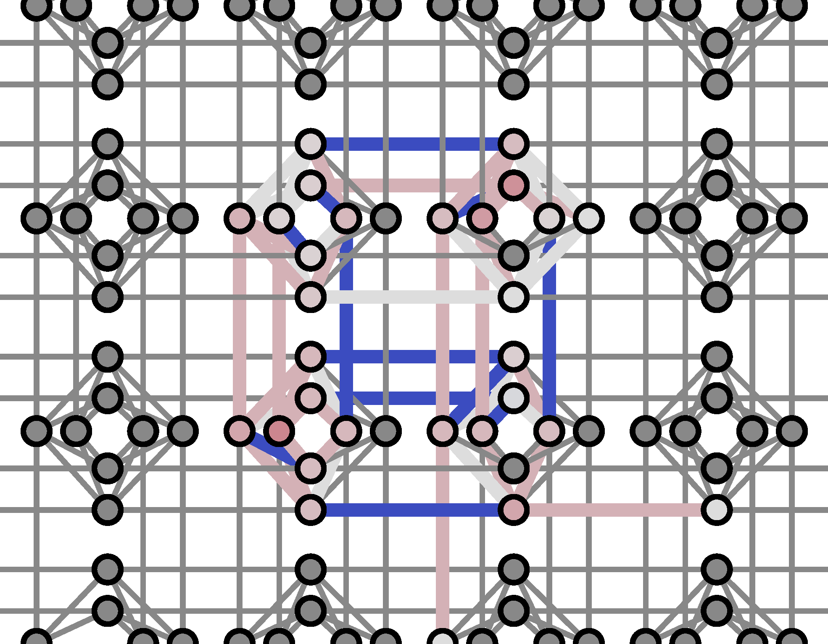
 |  | 3 | 4
3
4 |  | 1
 | 1
1 | 2 | 3 | 4
3 | 4 | 2 | 1
4 | 3 | 1 | 2
2 | 1 | 4 | 3
-2 | 4 | 0 | 0 | 0 | 0 | 0 | 0 | 0 | 0 | 0 | 0 | 0 | 0 | 0 | 0 | 0
0 | -2 | 4 | 4 | 4 | 0 | 0 | 0 | 0 | 0 | 0 | 0 | 0 | 0 | 0 | 0 | 0
0 | 0 | -2 | 0 | 0 | 0 | 4 | 0 | 0 | 4 | 0 | 0 | 0 | 0 | 0 | 4 | 0
0 | 0 | 0 | -2 | 4 | 0 | 4 | 0 | 0 | 0 | 0 | 0 | 0 | 0 | 0 | 0 | 0
0 | 0 | 0 | 0 | -2 | 4 | 4 | 0 | 4 | 0 | 0 | 0 | 4 | 0 | 0 | 0 | 0
0 | 0 | 0 | 0 | 0 | -2 | 0 | 0 | 0 | 0 | 0 | 0 | 0 | 0 | 0 | 0 | 0
0 | 0 | 0 | 0 | 0 | 0 | -2 | 4 | 0 | 0 | 0 | 0 | 0 | 4 | 0 | 0 | 0
0 | 0 | 0 | 0 | 0 | 0 | 0 | -2 | 0 | 0 | 0 | 0 | 0 | 0 | 4 | 0 | 0
0 | 0 | 0 | 0 | 0 | 0 | 0 | 0 | -2 | 4 | 0 | 0 | 4 | 0 | 0 | 0 | 0
0 | 0 | 0 | 0 | 0 | 0 | 0 | 0 | 0 | -2 | 4 | 0 | 0 | 4 | 0 | 4 | 0
0 | 0 | 0 | 0 | 0 | 0 | 0 | 0 | 0 | 0 | -2 | 0 | 0 | 0 | 0 | 0 | 0
0 | 0 | 0 | 0 | 0 | 0 | 0 | 0 | 0 | 0 | 0 | -2 | 4 | 0 | 0 | 0 | 0
0 | 0 | 0 | 0 | 0 | 0 | 0 | 0 | 0 | 0 | 0 | 0 | -2 | 4 | 0 | 4 | 0
0 | 0 | 0 | 0 | 0 | 0 | 0 | 0 | 0 | 0 | 0 | 0 | 0 | -2 | 4 | 4 | 0
0 | 0 | 0 | 0 | 0 | 0 | 0 | 0 | 0 | 0 | 0 | 0 | 0 | 0 | -2 | 0 | 4
0 | 0 | 0 | 0 | 0 | 0 | 0 | 0 | 0 | 0 | 0 | 0 | 0 | 0 | 0 | -2 | 4
0 | 0 | 0 | 0 | 0 | 0 | 0 | 0 | 0 | 0 | 0 | 0 | 0 | 0 | 0 | 0 | -2

Slide 16
Ergebnisse
Anzahl der Ergebnisse des n-Damenproblems von n=4 bis n=8 pro 10000 Durchläufe

Slide 17
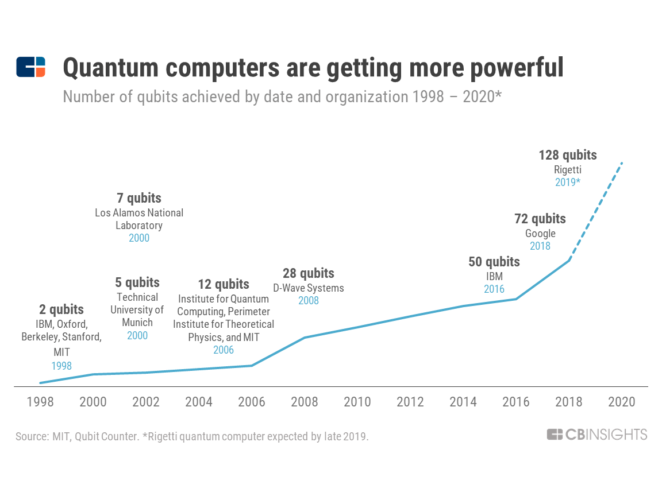
Quantenüberlegenheit

